Slide 1


Optimization1 of Stem Pairing
Week 8 Hua Jiang

Slide 2
Include length into score calculation
2. Solve Rhombus segmentations problem by
(1) filtering out small pattern, (2) rectification on pairing algorithm
3. Optimization of orientation tolerance
4. Optimization of small score strategy and distance calculation
5. Horizontal stem problem

Slide 3
Include length into score calculation
radius = abs(np.linalg.norm(inter - c2) - (l2[0]+l2[1])/2)/(1 + 1.5 * (conf2 ** 2))
Original calculation with the intersection of vectors
The longer, the larger confidence (from 0 to 1). So the original score will be divided by 1 to 2.5 (to limit the effect of the length)

Slide 4

2. Solve Rhombus segmentations problem
(1) filter out small segmentation when pixels < 100
(2) Add filter on the pairing strategy:
Stem A as base stem, if Stem B is its best candidates with lowest score b, we must check, for Stem B as the base stem, if Stem A score a is not much different from Stem B score b.
If abs(a - b) > 30, this is a false pairing. Then Stem A has to move to the second best candidate and iterately check the if the filter condition is satisfied

Slide 5

2. Filter on the pairing strategy
The score is way too large to be best candidate
Base Stem
True Partner
Move to seek the next
Best candidate
Base Stem

Slide 6
3. Optimization of orientation tolerance
ang – ang_pos < 15 °
The larger ang_pos, the larger ang tolerance
The stem right on the stem line is not supposed to have large ang difference.
Here should be less than 15° if ang_pos is 0
20°
ang_pos
ang

Slide 7

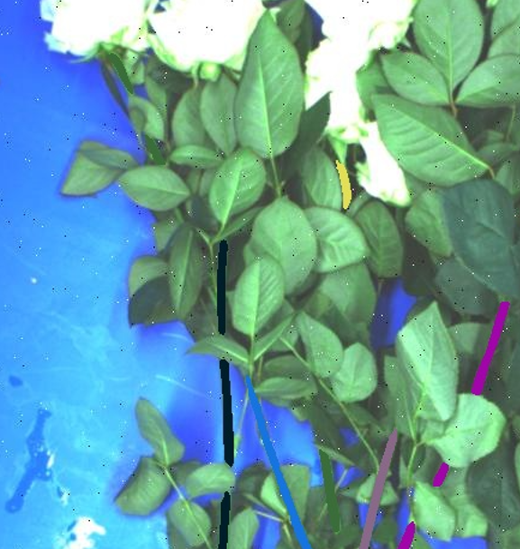
3. Optimization of orientation tolerance
Base Stem
Filtered out
Neighbor
Best candidate

Slide 8
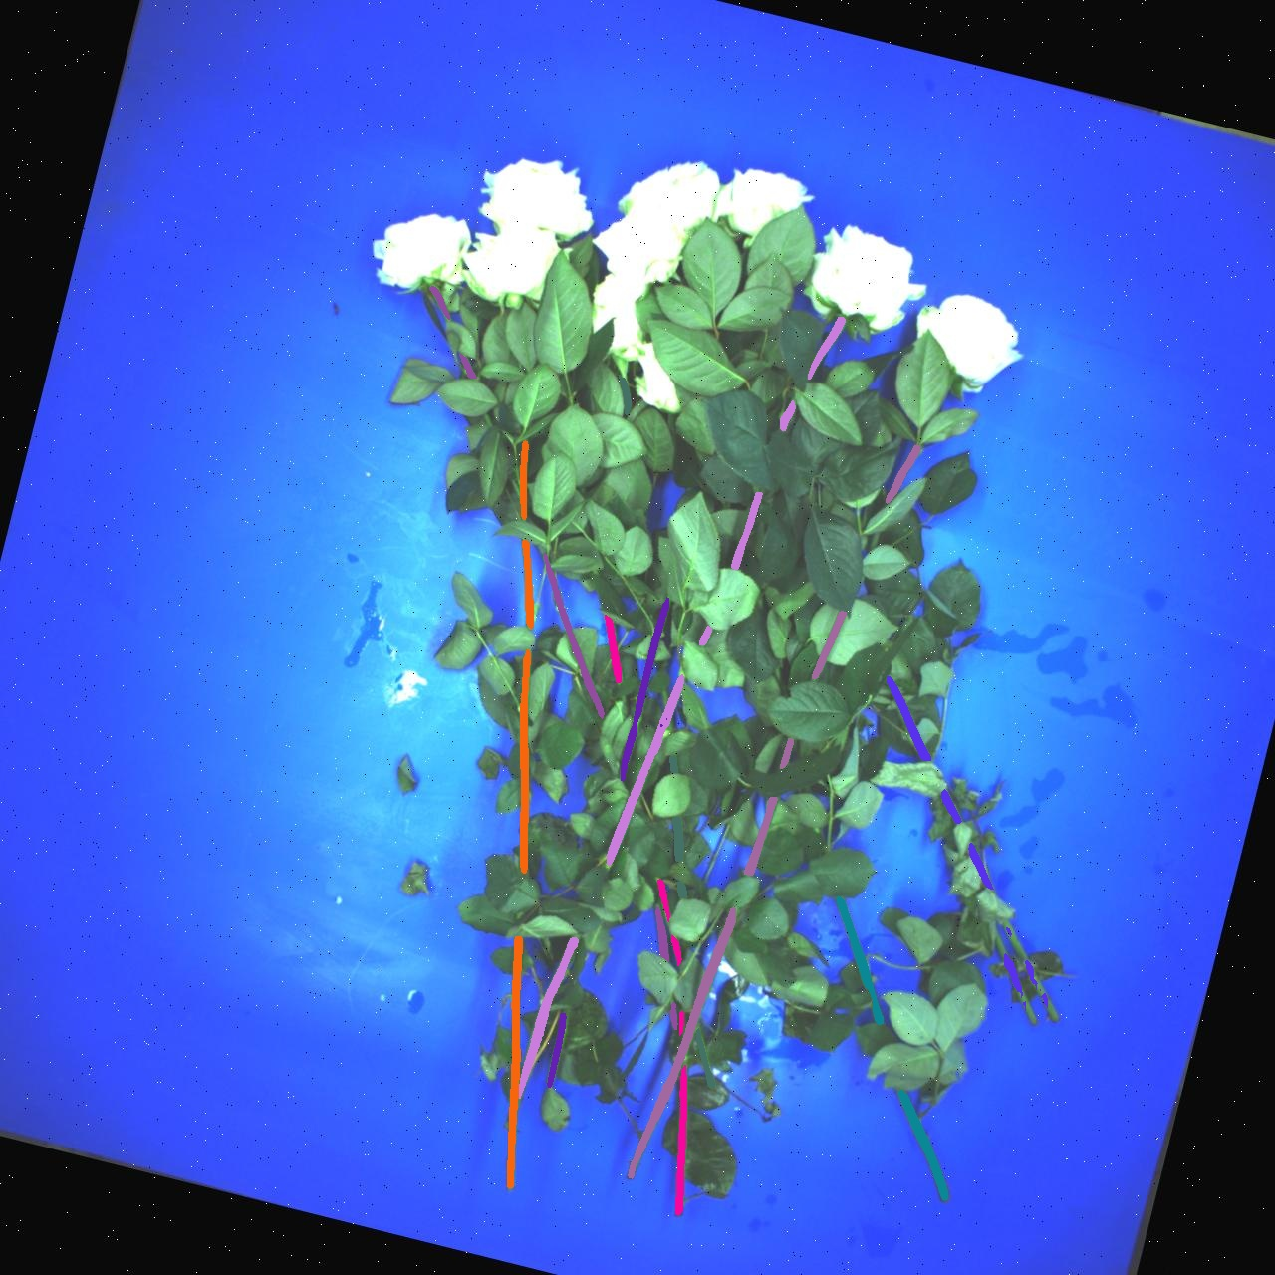
3. Optimization of orientation tolerance
Base Stem
Neighbor is found
Neighbor
Best candidate

Slide 9
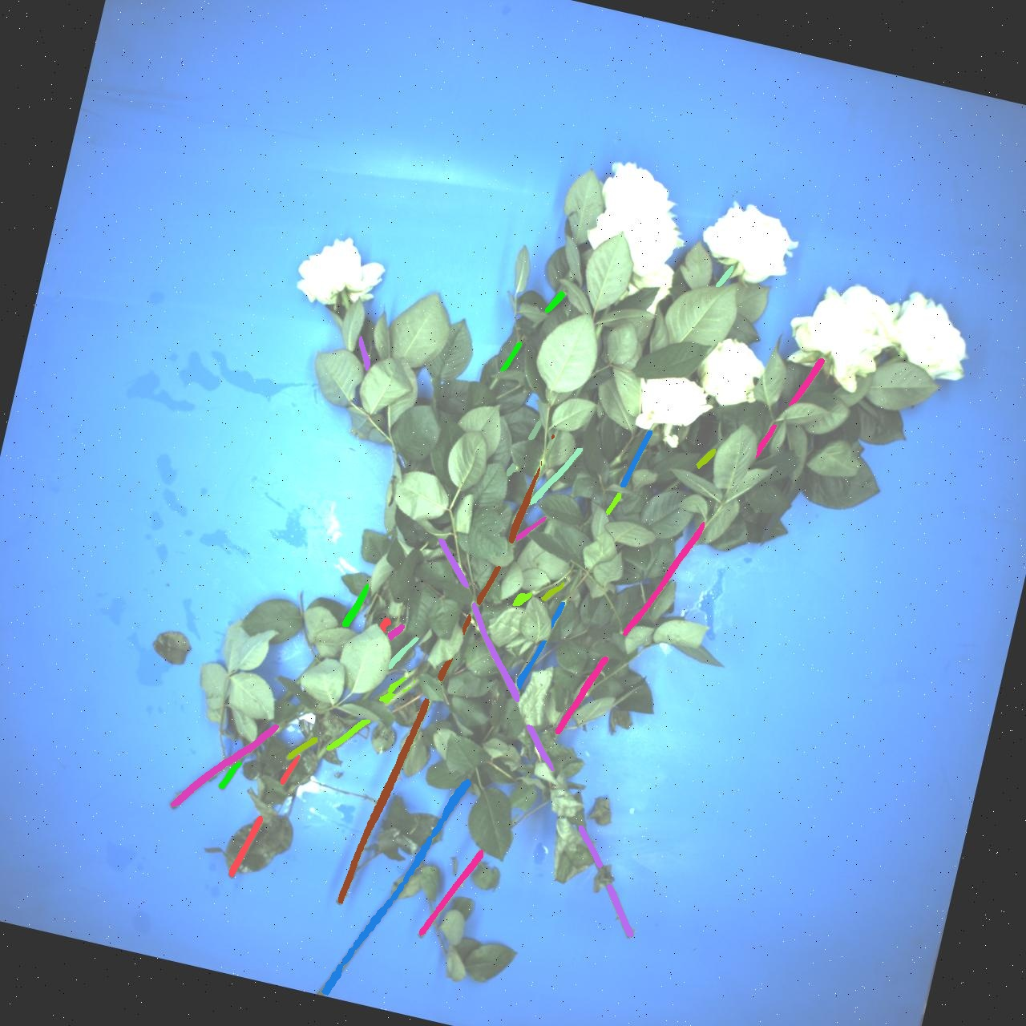
4. Optimization of small score strategy
If the candiate score is less than 3, just compare the distance
(2) If the score is 3 – 11, compare the score * distance
(3) Else, compare the score
The neighbor is skipped by comparing the score*distance (1<)
Base Stem
The distance is calculated by:
Best candidate (0.1)
Instead of the distance between centers, we calculate the top-bottom distance because the longer stem is more persuasive

Slide 10
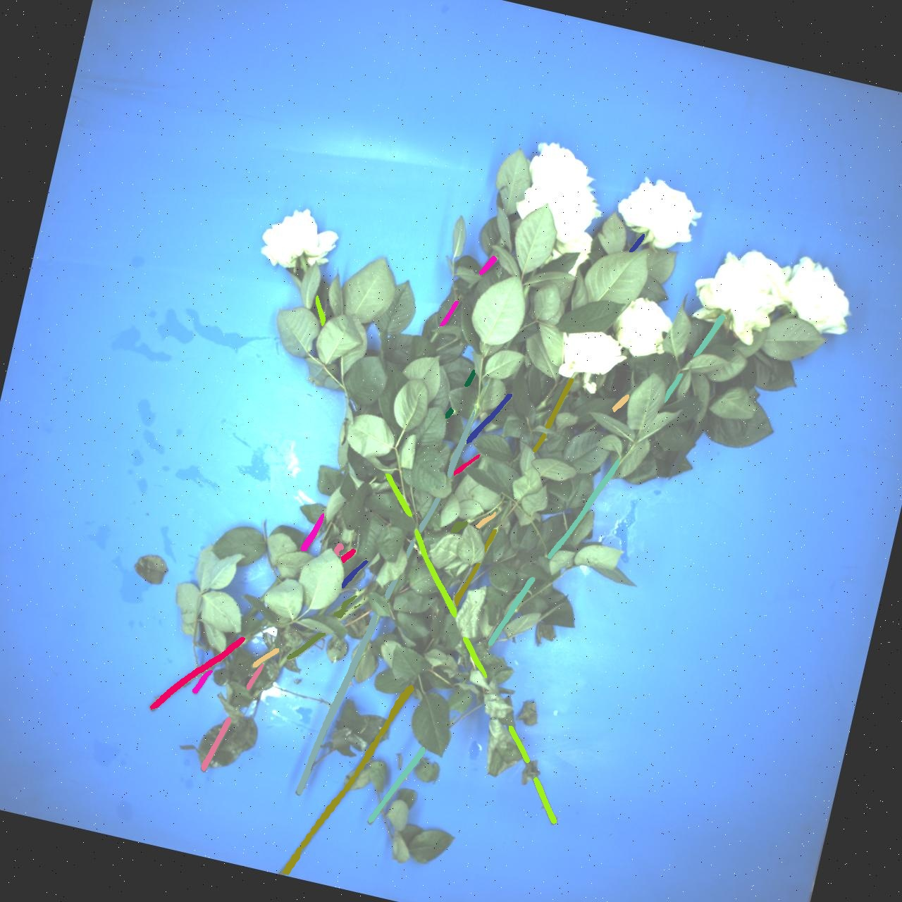
4. Optimization of small score strategy
The neighbor is skipped by comparing the score*distance (1<)
Base Stem
Best candidate (0.1)

Slide 11
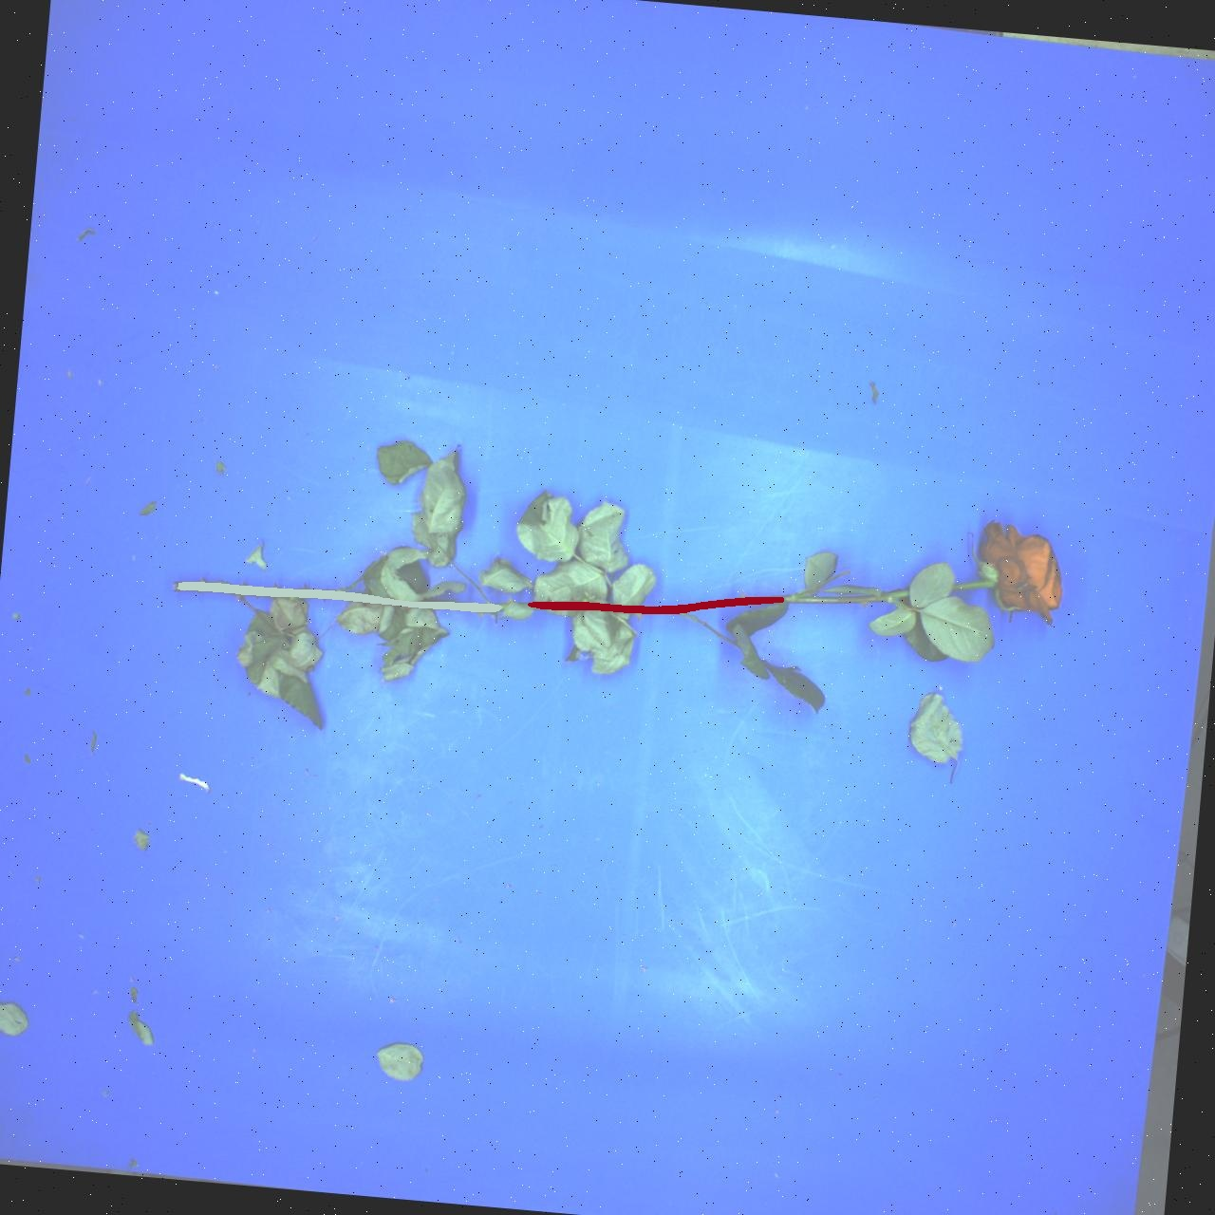
5. Horizontal stem problem
They are each others lower candidate so won’t be paired
upper
lower
lower
So I have to reverse the vector temporarily

Slide 12
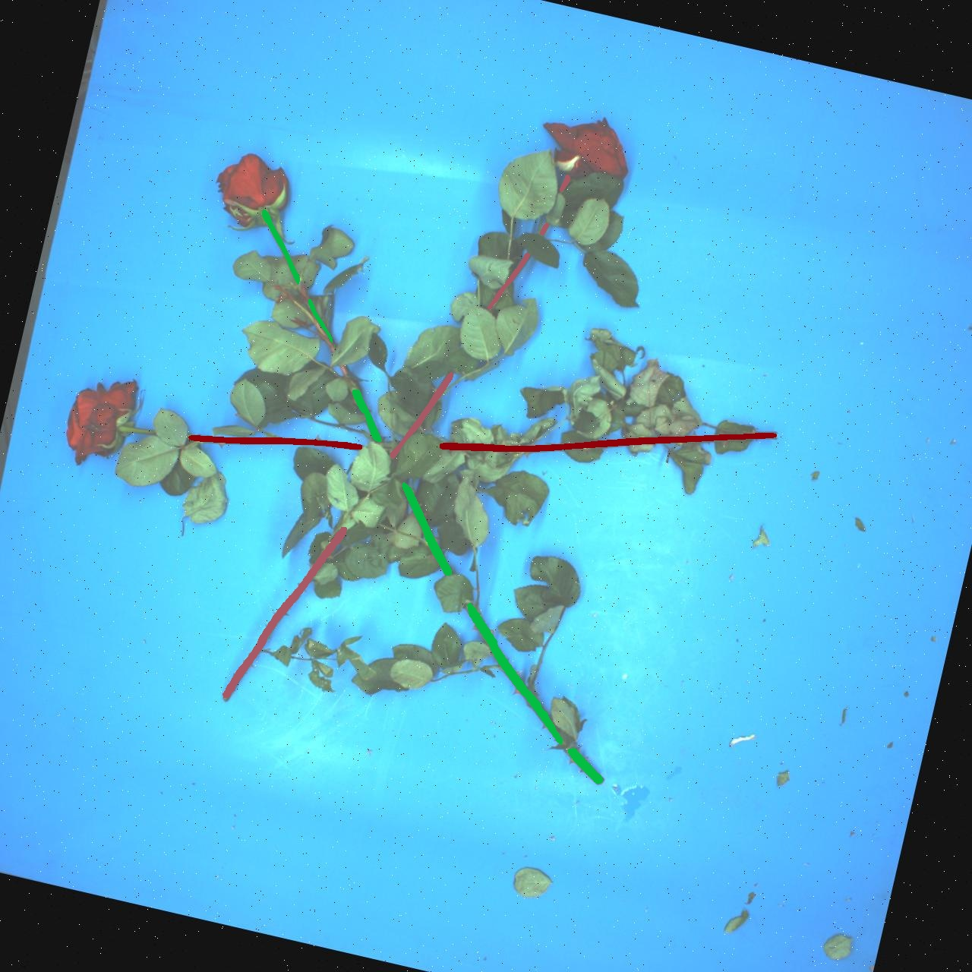
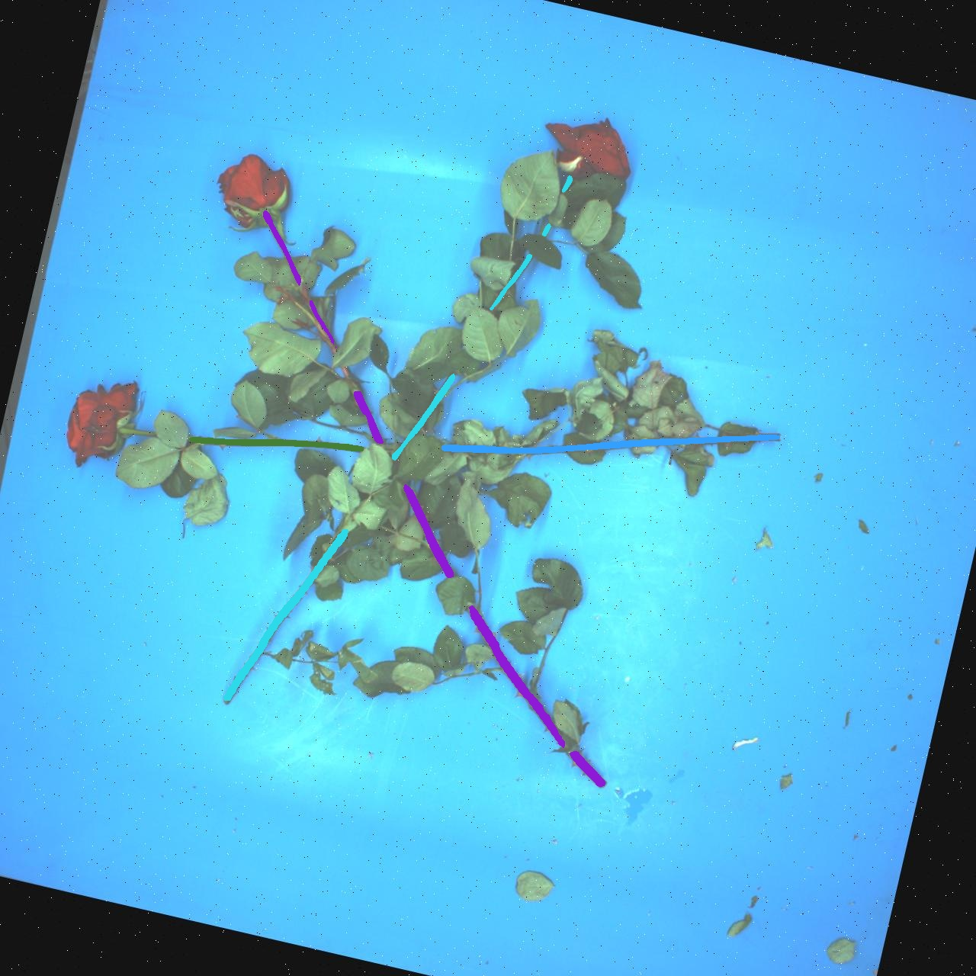
5. Horizontal stem problem

Slide 13
Future Work:
Optimization2

